Slide 1
Risk-Takers
Basic 6

Slide 2
Risk Taker

Slide 3
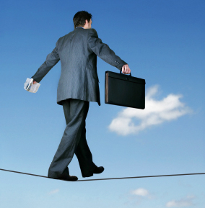
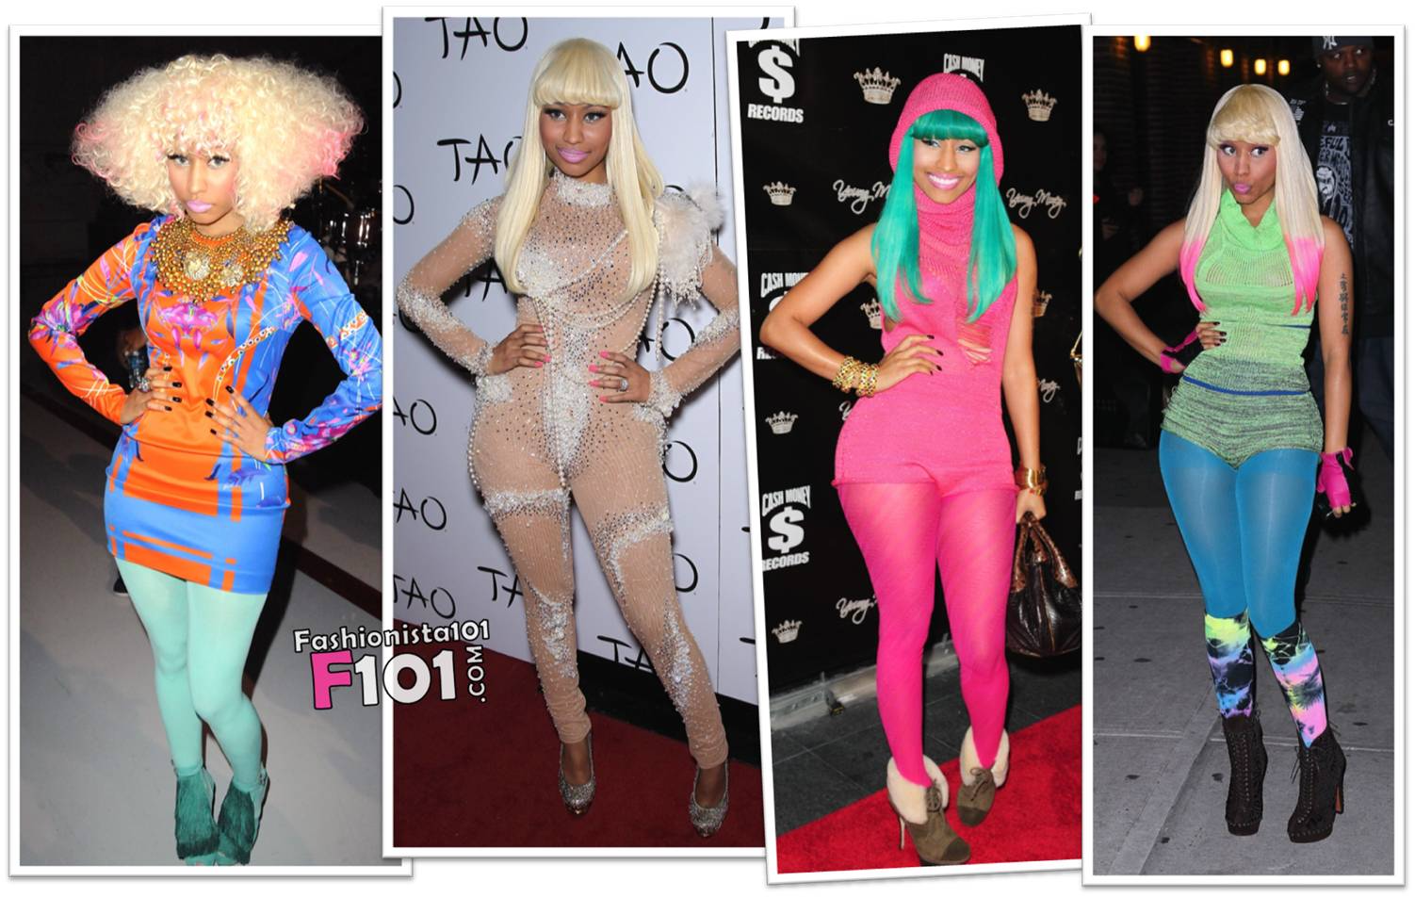
Risk Takers

Slide 4
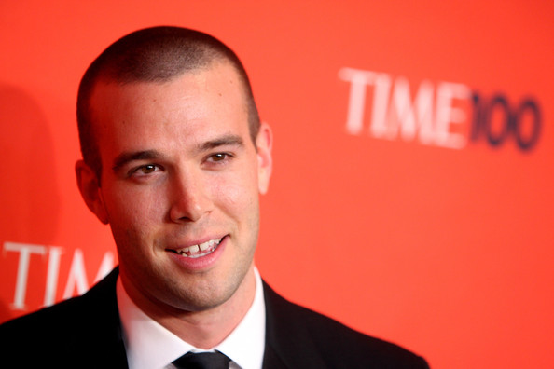
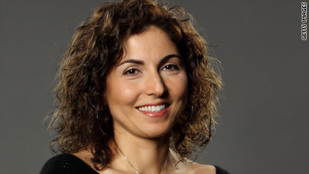
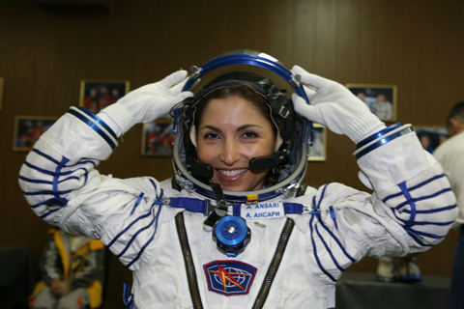
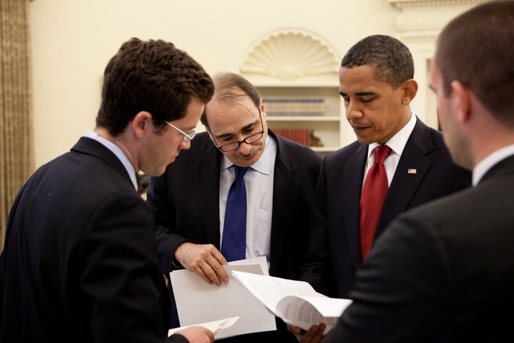

Slide 5

A speaker gives speaches in front of a group of people

Slide 6
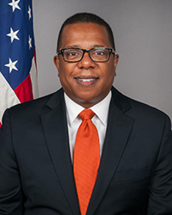
He is Bryan Nichols. He is the American Ambassador in Peru.

Slide 7



A researcher researchs (finds/investigates) information about different topics.

